Slide 1



VISIT SCHEDULING • VERSION 2
Who should we
offer this visit to?
A scoring rule that ranks coordinators for every open home visit
Fair rotation, family continuity, and honest workload, in one number
For lab team and PI review • August 2026
Notes:
Version 2 reweights the model so family history carries the most weight, corrects the family history formula, and returns a ranked list instead of a single pick.

Slide 2




THE GOAL
Fair and efficient, at the same time
Fair
Efficient
No coordinator carries a heavier share than the rest, once travel and visit length are counted honestly.
Visits get filled quickly with someone the family already trusts, without a chain of phone calls.
FOUR THINGS THE RULE LOOKS AT
Availability
Visit history
Workload
Family preference
Open slot inside the date window, and no clash on the calendar.
How many times this coordinator has already seen this family.
Scheduled hours this period, plus round trip travel time.
Whether the family wants a familiar face or a fresh one.
The Early Social Development Lab at UofSC
2
Notes:
Fairness and efficiency pull against each other. The weights are where we choose the trade.

Slide 3
HOW IT RUNS
Filter, then score, then rank
LAYER 1
LAYER 2
LAYER 3
Filter
Score
Rank
Drop anyone who cannot take
this visit. Pass or fail.
Give everyone left one number
between 0 and 1.
Return an ordered short list,
not a single name.
Nothing is traded
Everything at once
A person still chooses
Eligibility is not a penalty. A missing credential cannot be outscored by a short drive.
Five things we care about are folded into one number so they can be compared directly.
The coordinator sees the top few with reasons, and picks. Close calls get flagged.
The Early Social Development Lab at UofSC
3
Notes:
The change from version 1 is Layer 3. It used to pick one person. It now returns a ranked short list.

Slide 4












READING THE SYMBOLS
What each symbol stands for
One coordinator who could take the visit
Hours already scheduled this period
One visit request that needs filling
Round trip travel time in minutes
Visits this coordinator has done with this family
The pool of coordinators who cleared Layer 1
How many visits it takes to feel familiar, currently 2
The final score, always between 0 and 1
Family flag: plus one wants a familiar face, minus one wants a fresh one
Score gap below which the top two get flagged for review
Days since this coordinator's last visit of any kind
The small bonus for having done the previous checkpoint
The Early Social Development Lab at UofSC
4
Notes:
Subscript i is the coordinator, f the family, v the visit.

Slide 5
LAYER 1
Four eligibility checks, all must pass
A
X
E
K
Open slot
No clash
No conflict
Credentialed
A free block inside the requested date window.
Nothing already booked over that block on their calendar.
Not on this family's do not send list.
Holds every credential this study type requires.
The wedge means and. The hooked bar means not. All four have to hold at the same time.
Availability and clash come from the calendar, so both are only as fresh as the last sync.
If nobody clears all four, the visit goes to the coordinator to reschedule. The score is never used to rescue an ineligible person.
The Early Social Development Lab at UofSC
5
Notes:
X is new in version 2. Version 1 assumed availability was already conflict free.

Slide 6
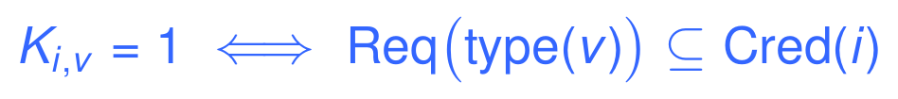
LAYER 1, THE CREDENTIAL CHECK
Study type decides what a coordinator needs
Read it as: the visit type's required credential list has to be a subset of what this coordinator holds.
NICO
Study protocol
NANO
Study protocol
Required list lives in the protocol record. Nothing about it is hard coded.
Same lookup, different list. Adding a third study means adding a row, not editing code.
Why this matters
Nico and Nano differ on things like ADOS administration and who can take consent. Keeping that in a lookup table means the two studies never need two versions of the scoring code, and a protocol change is a data edit.
The Early Social Development Lab at UofSC
6
Notes:
Fill the required credential lists with the PI before the pilot. The model does not care what is in them.

Slide 7
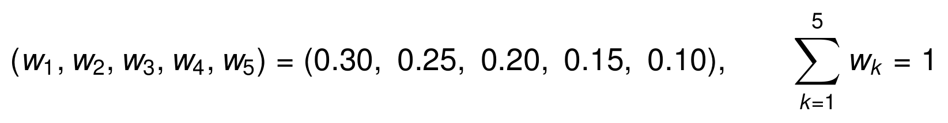
LAYER 2
One score, five parts, new weights
w₁ = 0.30
w₂ = 0.25
w₃ = 0.20
w₄ = 0.15
w₅ = 0.10
Family history
Recency
Workload
Travel
Continuity
How well this coordinator already knows the family
How long since their last visit of any kind
Hours already booked this period
Round trip travel time for this visit
Bonus for having done the previous checkpoint
Family history now carries the most weight, and every part is scaled to the same range, so the score itself is always between 0 and 1.
The Early Social Development Lab at UofSC
7
Notes:
The bounded range is only true because the family history term was rewritten. See the next slide.

Slide 8
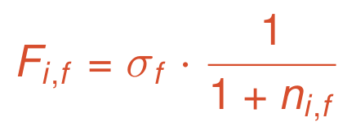
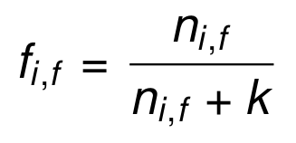
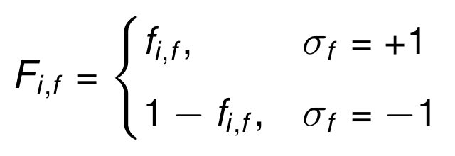
THE ONE REAL FIX
The family history term was backwards
VERSION 1
VERSION 2
With the flag set to plus one, meaning the family wants a familiar face, this score falls as prior visits rise. The sign and the shape disagreed, so the term did the opposite of its label.
Familiarity climbs from 0 toward 1 as visits add up. The flag then picks the direction: keep it for a familiar face, invert it for a fresh one. No negative scores.
WHAT THE NUMBERS LOOK LIKE, WITH k = 2
Prior visits with this family | 0 | 1 | 2 | 4 | 8
Familiarity | 0.000 | 0.333 | 0.500 | 0.667 | 0.800
Score, family wants a familiar face | 0.000 | 0.333 | 0.500 | 0.667 | 0.800
Score, family wants a fresh face | 1.000 | 0.667 | 0.500 | 0.333 | 0.200
A coordinator who has never met the family now scores 0 on continuity, not 1. That was the bug worth catching before this term became the heaviest one.
The Early Social Development Lab at UofSC
8
Notes:
This inconsistency was in the source document: the prose said more prior visits should raise the score, the formula lowered it.

Slide 9
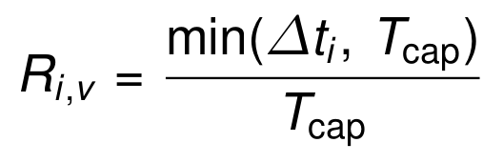
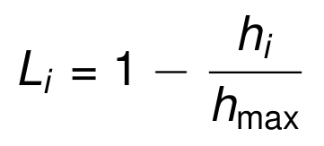
PARTS TWO AND THREE
Recency and workload
2
Recency
weight 0.25
3
Workload
weight 0.20
Days since this coordinator's last visit, capped at a ceiling such as 90 days.
Hours already scheduled this period, against the busiest person on the team.
Someone who worked yesterday scores near 0. Someone free for three months scores 1. This is what keeps the rotation moving.
Counting hours instead of visit counts is the change here. A morning of long assessments no longer looks the same as two short check ins.
The Early Social Development Lab at UofSC
9
Notes:
Hours per period needs a definition: scheduled contact hours, or contact plus documentation. Decide before the pilot.

Slide 10
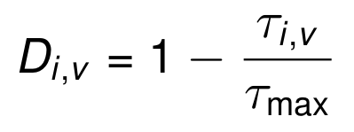
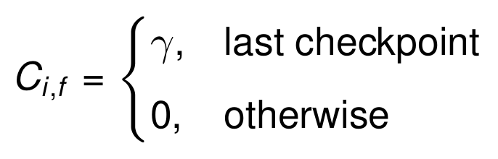
PARTS FOUR AND FIVE
Travel and continuity
4
Travel
weight 0.15
5
Continuity
weight 0.10
Round trip travel time, against the longest trip in the eligible pool.
A small fixed bonus, about 0.05, for doing the last checkpoint.
Minutes replaced miles. Travel time and scheduled hours are now in the same unit, so the two together describe the real burden of a visit.
Kept deliberately small. Family history already carries continuity at weight 0.30, so this only breaks near ties in favour of the last familiar face.
The Early Social Development Lab at UofSC
10
Notes:
Travel time should come from a routing lookup cached per coordinator and family, not computed live on every scoring run.

Slide 11
A COMMON QUESTION
Where does family preference actually live?
It is not a sixth term. It shows up in three places, each with a different amount of force.
STRONGEST
MIDDLE
LIGHTEST
A hard override in Layer 1
The direction of the family history term
The tie break in Layer 3
A named request or an exclusion removes people from the pool outright. No score can undo it.
The flag decides whether familiarity helps or hurts, at the heaviest weight in the model.
When the top two are effectively level, prior visits with the family settle it.
The reason for the split
A comfort concern is a stop sign, not a penalty. Folding it into the score would let a short drive and a light caseload quietly outvote it, which is exactly what we do not want to happen.
The Early Social Development Lab at UofSC
11
Notes:
This slide exists because the question comes up every time someone new reads the model.

Slide 12
WORKED EXAMPLE, STEP ONE
Three eligible coordinators, one visit
What we measure | A | B | C
Prior visits with this family | 3 | 0 | 1
Familiarity, k = 2 | 0.600 | 0.000 | 0.333
Family history score | 0.600 | 0.000 | 0.333
Days since last visit | 5 | 20 | 40
Recency score | 0.056 | 0.222 | 0.444
Hours booked this period | 18 | 9 | 12
Workload score | 0.000 | 0.500 | 0.333
Round trip minutes | 30 | 75 | 45
Travel score | 0.600 | 0.000 | 0.400
Did the last checkpoint | Yes | No | No
Continuity bonus | 0.050 | 0.000 | 0.000
The setup
This family wants a familiar face, so the flag is plus one. Every score in blue is computed from the raw row directly above it.
A
The veteran
Knows the family best and lives closest, but is fully booked and worked five days ago.
B
The newcomer
Lightest caseload on the team, but has never met this family and faces the longest drive.
C
The middle
Nothing outstanding anywhere, nothing weak anywhere.
Illustration only. Real numbers come out of the pilot.
The Early Social Development Lab at UofSC
12
Notes:
Note that no candidate wins on more than two of the five parts.

Slide 13
WORKED EXAMPLE, STEP TWO
Multiply, add, then rank
COORDINATOR A
RANK 2
COORDINATOR B
RANK 3
COORDINATOR C
RANK 1
What this shows
C takes the top slot without leading on a single part. A has the deepest history and the shortest drive but is fully booked and worked last week, which zeroes out two terms. The gap between C and A is 0.049, inside the 0.05 review band, so the pair is flagged for a coordinator to look at rather than confirmed silently.
The Early Social Development Lab at UofSC
13
Notes:
Under version 1 weights and the old family term, B would have won this. The reweighting is what moved the answer.

Slide 14

LAYER 3
A ranked short list, not a single name
Offer the top K
Flag a thin margin
Break a true tie
The coordinator sees the best few with their scores and the reason each one ranked where it did. Currently K is 3.
If the first and second are closer than the review band, the pair goes to a human before anything is confirmed.
If the gap is smaller still, prior visits with the family settle it in whichever direction the family flag points.
Ranking rather than picking is the honest move. The score separates a strong candidate from a weak one reliably, but it cannot tell 0.338 apart from 0.289 in any way a person should trust blindly.
The Early Social Development Lab at UofSC
14
Notes:
Set the review band and the tie tolerance from pilot data, not from intuition.

Slide 15
OPEN PROBLEM
A brand new coordinator breaks three of the five parts
Part | What a new hire looks like | What the score does | Right or wrong
Family history | No prior visits anywhere | 0 for a family wanting continuity | Right
Recency | No last visit on record | Undefined, or treated as a very long gap and scored 1 | Wrong
Workload | Nothing booked yet | 1, the maximum | Wrong
Travel | Distance is known from their address | Scores normally | Right
Continuity | Did not do the last checkpoint | 0 | Right
PROPOSED FIX
Until a coordinator has a handful of visits on record, borrow the team median for recency and workload instead of letting an empty record read as maximum availability. A new hire then starts in the middle of the pack and earns their own numbers, rather than being handed every visit in week one.
The Early Social Development Lab at UofSC
15
Notes:
Pick N_min with the team. Five completed visits is a reasonable starting guess, not a validated number.

Slide 16

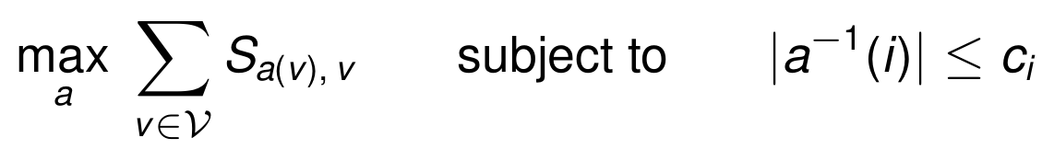
OPEN PROBLEM
Filling visits one at a time leaves value on the table
Scoring one visit against one pool is greedy. Two harder questions sit behind it, and they are different problems with different tools.
ONE PERSON, ONE DAY
WHOLE TEAM, WHOLE WEEK
Which set of visits fits?
Who takes which visit?
Pick the highest scoring set of non overlapping slots for a single coordinator. This is weighted interval scheduling, and dynamic programming does solve it: sort by end time, and for each visit take either the best answer without it or its score plus the best answer ending before it starts.
Maximise total score across all open visits while respecting each person's capacity. This is an assignment problem, not a dynamic programming one. The standard tools are the Hungarian algorithm for one visit each, or minimum cost flow once people can take several.
Runs in about n log n time, dominated by the sort.
I am stating a standard result here. Worth confirming against a reference before implementation.
The Early Social Development Lab at UofSC
16
Notes:
Neither is needed for the pilot. Greedy per visit is fine while the weekly volume is small.

Slide 17
THE BLOCKER
Availability has to come from the calendar
Layer 1 cannot run on a spreadsheet of stated availability. Both checks, open slot and no clash, need live free and busy data.
Outlook, via Microsoft Graph
Google Calendar
POST /users/{id}/calendar/getSchedule
POST /calendar/v3/freeBusy
Least privileged permission is Calendars.Read
Scope calendar.readonly is enough
Works delegated or app only with admin consent
Returns busy blocks per calendar
Up to 20 calendars per call, window under 62 days
Needs timeMin, timeMax, and a list of calendar ids
What we get back
Before anyone builds this
Busy blocks, not event details. That is all Layer 1 needs, and it keeps personal calendar content out of the system entirely.
Endpoints and scopes were checked in August 2026 and both vendors change them. Confirm against current documentation, and settle the IRB position on reading staff calendars first.
The Early Social Development Lab at UofSC
17
Notes:
Sources: Microsoft Learn calendar getSchedule reference, and Google Workspace Calendar API freebusy query reference.

Slide 18
NEXT STEPS
What the pilot has to answer
1
Wire the calendar read
Get free and busy data flowing for the whole team on a read only scope. Nothing else can be tested until Layer 1 is real.
Blocked on IRB and IT
2
Replay past visits
Run the model over assignments already made and compare its ranking to what the team actually chose. Disagreements are the interesting cases.
Needs six months of history
3
Tune the weights
Adjust from the replay, not from opinion. Record the version and effective date so any past decision stays reproducible.
One afternoon with the PI
4
Debrief the surprises
Every case where the model and the team disagreed gets read out loud. Some will be model bugs, some will be undocumented rules worth writing down.
Standing item, first month
The pilot is a comparison, not a rollout. Nothing gets assigned automatically until the replay stops surprising us.
The Early Social Development Lab at UofSC
18
Notes:
Step 2 is the one that earns trust with the team. Lead with it.

Slide 19

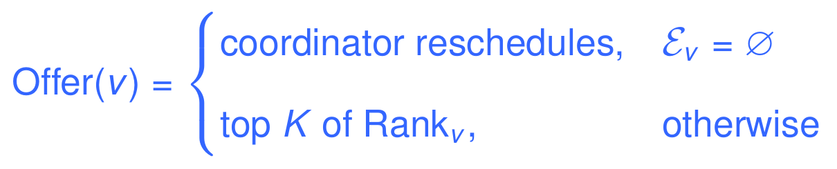

WHERE VERSION 2 LANDS
Rank a few good options.
Let a person choose between them.
Reweighted
Honest about burden
Still unfinished
Family history now leads at 0.30, and the term behind it was rewritten so it finally matches its own label.
Hours and travel minutes instead of visit counts and miles, so a long assessment day counts as one.
Calendar access, new hire cold start, and joint scheduling are open. The pilot exists to close them.
Notes:
Ask for two decisions today: the starting weights, and whether IRB allows reading staff calendars.

